Slide 1
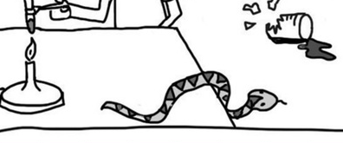
Daily Review
When considering potential hazards (dangers/risks) in a Science lab, we need to use the following steps:
Identify the hazard
Work out how the hazard could cause harm
Write a rule that will protect you from the hazard (make it positive if possible: try not to use “don’t”)
For example:
A snake is loose in the lab
The snake could bite someone or knock something over
Animals should be supervised at all times
Notes:
Daily review

Slide 2
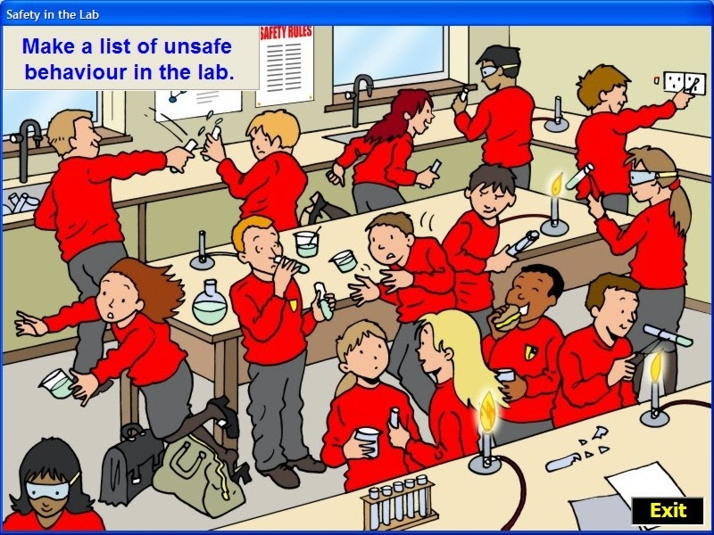
Daily Review
Write the numbers 1, 2 and 3 down the side of your whiteboard.
Choose one hazard in the following picture and:
Identify the hazard
Work out how the hazard could cause harm
Write a rule that will protect you from the hazard
Notes:
Daily review

Slide 3
Laboratory Equipment Year 7 Science

Slide 4
Learning Objectives
CFU
In your own words: what are we going to learn?
Identify the different pieces of equipment we will be using in the lab.
Draw scientific diagrams of lab equipment.
Explain what the different pieces of equipment are used for.
Activate Prior Knowledge
On your whiteboard, name one piece of equipment that a scientist might use, and what it is used for. Use full sentences.
For example: “A scientist might use a thermometer to measure the temperature of a liquid or gas.”

Slide 5
Concept Development
CFU 1
What do scientists use drawings to show?
Scientists use a lot of different equipment for different tasks.
Scientists often use diagrams to show how they’re going to set up their equipment.
Rule up a new page and give it the heading “Scientific Equipment”. Put your pen down when you’re ready to continue.
CFU 2
What might be some of the advantages of using diagrams instead of words?
Vocabulary
di·a·gram (noun) A simple drawing used to show how something looks or works

Slide 6
Skill Development
Today, you’re going to be looking at some equipment and learning:
what it’s used for, and
how to draw it scientifically.
Using a pencil and a ruler, start drawing a table in your book. It should be almost as wide as your page and go all the way down the page.
Vocabulary
di·a·gram (noun) A simple drawing used to show how something looks or works

Slide 7
Skill Development
Today, you’re going to be looking at some equipment and learning:
what it’s used for, and
how to draw it scientifically.
Divide your table in half going down the page.
Vocabulary
di·a·gram (noun) A simple drawing used to show how something looks or works

Slide 8
Skill Development
Today, you’re going to be looking at some equipment and learning:
what it’s used for, and
how to draw it scientifically.
Divide the first column in half again going down the page.
Vocabulary
di·a·gram (noun) A simple drawing used to show how something looks or works

Slide 9
Skill Development
Today, you’re going to be looking at some equipment and learning:
what it’s used for, and
how to draw it scientifically.
Add the following headings to your table:
Name | Diagram | Purpose
Vocabulary
di·a·gram (noun) A simple drawing used to show how something looks or works

Slide 10

Skill Development
Today, you’re going to be looking at some equipment and learning:
what it’s used for, and
how to draw it scientifically.
Each time you complete a row, draw a single straight line across your table to start a new one, like this:
Name | Diagram | Purpose
Test tube |  | Holding or heating small amounts of chemicals
Vocabulary
di·a·gram (noun) A simple drawing used to show how something looks or works

Slide 11
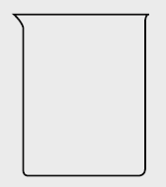
Skill Development
Today, you’re going to be looking at some equipment and learning:
what it’s used for, and
how to draw it scientifically.
Each time you complete a row, draw a single straight line across your table to start a new one, like this:
Name | Diagram | Purpose
Test tube |  | Holding or heating small amounts of chemicals
Beaker |  | Holding large amounts of chemicals Heating liquids
Vocabulary
di·a·gram (noun) A simple drawing used to show how something looks or works

Slide 12
Relevance
Knowing the names of scientific equipment will help you identify them during experiments.
Knowing how to draw scientific equipment will help you to communicate with other scientists.
Knowing the purpose of science equipment will help you choose the right equipment for the right task.

Slide 13
Independent Practice
Complete the table by looking at the science equipment around the room.
Use the information on the labels to fill out the table.

